Slide 1


Predicting CO2 Emissions from Fuel Consumption Data using Machine Learning
__KRUPANIDHI DEGREE COLLEGE__
DEPARTMENT OF COMPUTER SCIENCE_
MACHINE LEARNING INTERNSHIP_
Presentation on TOPIC :
PRESENTED BY
VARSHINI J
Under the guidance of :
PRINSTON SMART ENGINEERS

Slide 2
CONTENTS
Abstract
Introduction
Company Profile
Problem Statement
Objective
Dataset
Libraries Used
Implementation and Snapshots of the Project
Conclusion

Slide 3
ABSTRACT
The primary aim of this project is to leverage machine learning techniques to accurately predict CO2 emissions based on various vehicle attributes. In the context of increasing environmental concerns and stringent regulatory requirements, this project provides actionable insights for automotive manufacturers and policymakers to reduce carbon footprints. The project involves a comprehensive approach that includes data collection, preprocessing, feature engineering, model development, and evaluation.
A diverse range of machine learning algorithms, including Linear Regression, Decision Tree, and K-Nearest Neighbors (KNN), were implemented and rigorously tested to determine their efficacy in predicting CO2 emissions. Among these, the Decision Tree model consistently outperformed others, demonstrating superior predictive accuracy and robustness. This can be attributed to its ability to capture complex, non-linear relationships within the data.
Data preprocessing and feature engineering were critical components of the project, addressing issues such as missing values, outliers, and categorical variables to ensure data quality. Techniques such as mean imputation, outlier detection, one-hot encoding, and Recursive Feature Elimination (RFE) were employed to enhance the dataset's integrity and the model's performance.
The project also facilitated significant skill development, enabling the intern to gain proficiency in Python programming, data manipulation using libraries such as NumPy and Pandas, and the application of machine learning algorithms using scikit-learn. This hands-on experience in model optimization and evaluation honed the intern's analytical and problem-solving skills, laying a strong foundation for a career in data science.
The findings of this project hold substantial implications for environmental sustainability and regulatory compliance in the automotive industry. By understanding the key determinants of CO2 emissions, the project supports informed decision-making and policy formulation aimed at reducing emissions and promoting sustainable practices.

Slide 4
INTRODUCTION
As the global community becomes increasingly aware of the detrimental impacts of climate change, there is a growing emphasis on adopting sustainable practices across various sectors. Among these, the automotive industry stands out as a significant contributor to global CO2 emissions, necessitating focused efforts to mitigate its environmental impact. This project endeavors to harness the power of machine learning to predict CO2 emissions based on vehicle attributes, offering insights that could aid in regulatory compliance, policy development, and the advancement of sustainable transportation initiatives.

Slide 5
COMPANY PROFILE
Name : PRINSTON SMART ENGINEERS
Main office : Vishnuvardhan Statue Rd, Vishwa Priya Nagar, Begur, Bengaluru, Karnataka, 560068
Phone : 9513106196
Email : Prinston.Smart@gmail.com
Contact Person: Mrs. Farheen Farhath (Managing Director)
Year stand up : 2004
Company category : IT Software/ Embedded

Slide 6
PROBLEM STATEMENT
The automotive industry is a major contributor to global CO2 emissions, significantly impacting climate change and environmental sustainability. Accurately predicting CO2 emissions based on vehicle attributes is crucial for developing effective strategies to mitigate these emissions. However, the complexity and variability of factors influencing emissions present significant challenges. This project aims to address these challenges by employing machine learning techniques to develop robust predictive models. By analyzing attributes such as engine size, fuel consumption, vehicle class, and transmission type, the project seeks to provide actionable insights for policymakers and automotive manufacturers to reduce emissions and promote sustainable transportation practices.

Slide 7
OBJECTIVES
Develop Predictive Models: The core aim is to utilize state-of-the-art machine learning algorithms to develop robust models capable of accurately predicting CO2 emissions based on various vehicle attributes.
Evaluate Model Performance: A thorough evaluation of different machine learning algorithms is conducted to determine their effectiveness in predicting CO2 emissions, with the goal of identifying the most accurate and reliable models.
Understand Influencing Factors: This project seeks to analyze and understand the key factors that influence CO2 emissions from vehicles, including attributes such as engine size, fuel consumption, vehicle class, and transmission type. Such an understanding is crucial for developing strategies to reduce emissions.
Inform Policy and Decision Making: The insights derived from this study are intended to provide valuable guidance to policymakers, automotive manufacturers, and other stakeholders. This will support efforts to reduce emissions, comply with environmental regulations, and promote the adoption of sustainable transportation practices.

Slide 8
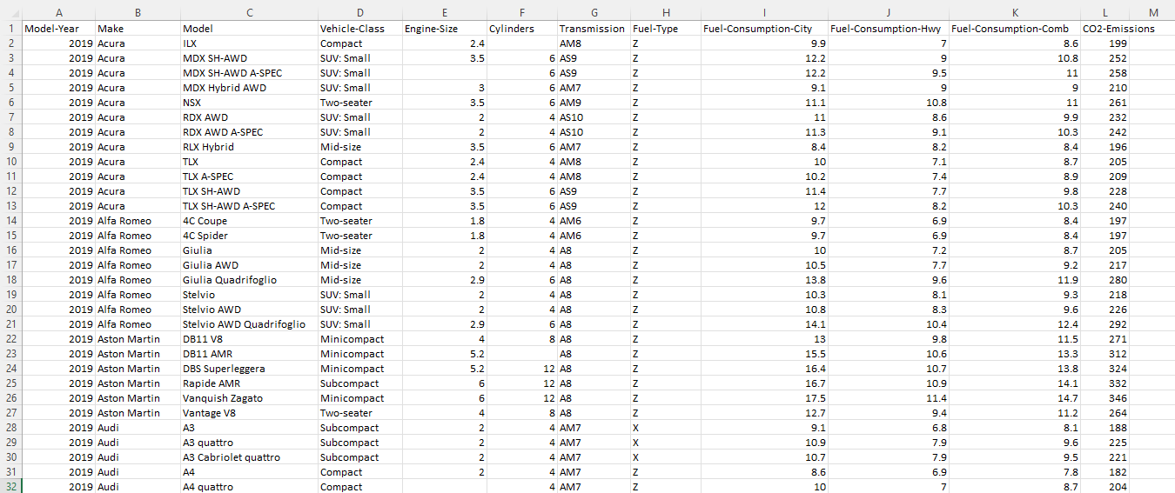
DATASET

Slide 9
LIBRARIES
Pandas: Pandas is a powerful library for data manipulation and analysis. Pandas can be used to load mutual fund data from CSV files and preprocess the data for machine learning models.
Scikit-learn: Scikit-learn is a popular library for machine learning in Python. Scikit-learn also includes tools for data preprocessing, model selection, and model evaluation. Scikit-learn can be used to train machine learning models for mutual fund classification and regression.
Matplotlib: Matplotlib is a plotting library that is ideal for creating visualizations in Python. Matplotlib can be used to create visualizations of mutual fund data to help investors understand the performance of different funds and categories.
Seaborn: Seaborn is a visualization library that builds on top of Matplotlib. Seaborn can be used to create more advanced visualizations of mutual fund data to identify patterns and relationships in the data.

Slide 10
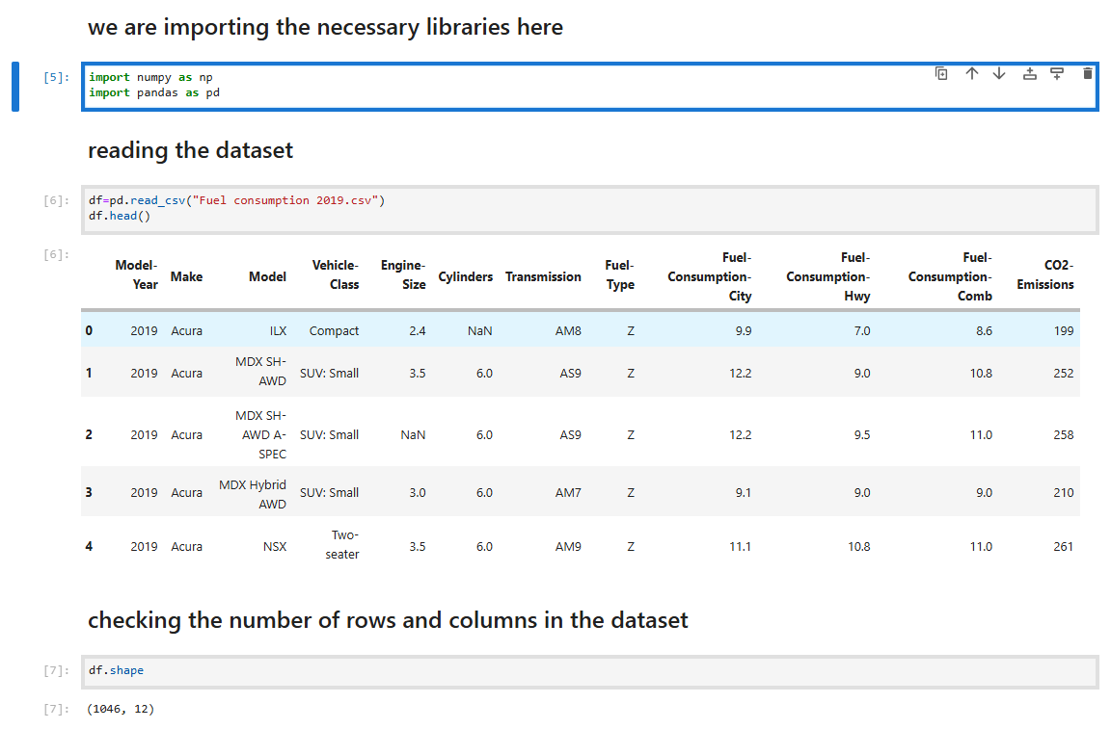
IMPLEMENTATION

Slide 11
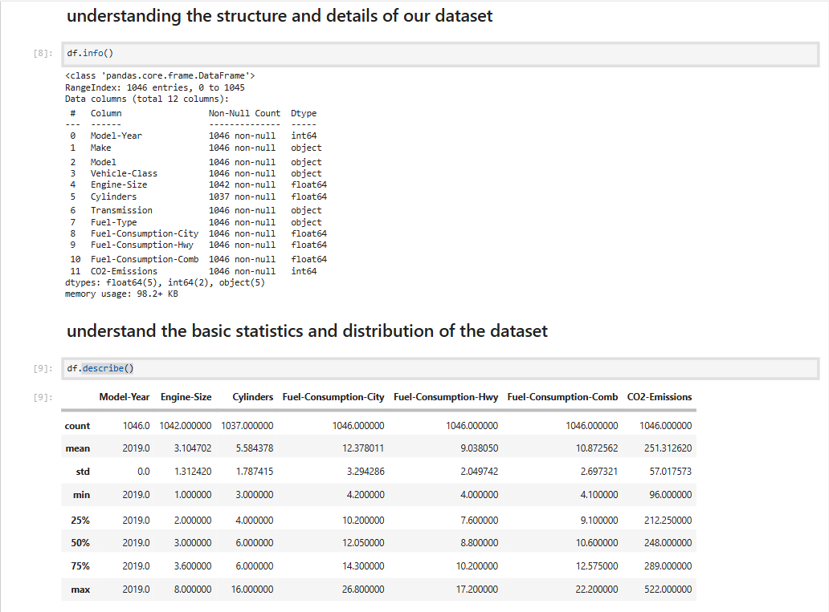

Slide 13
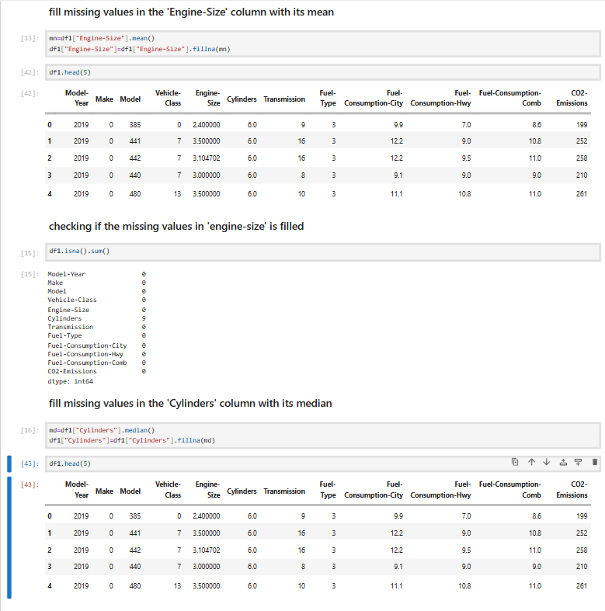

Slide 14
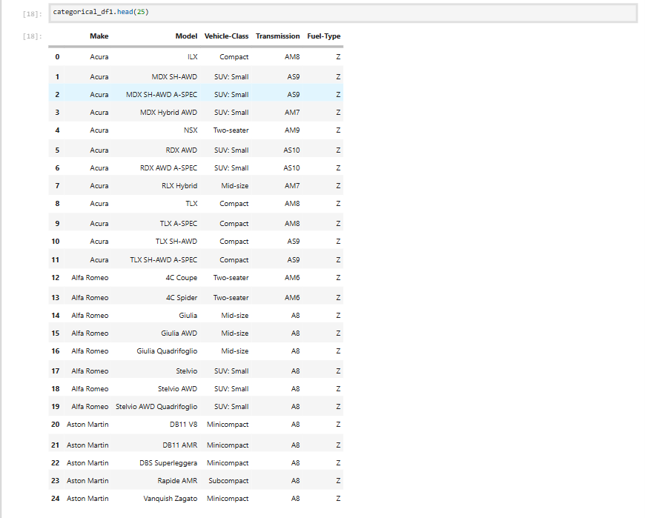

Slide 15
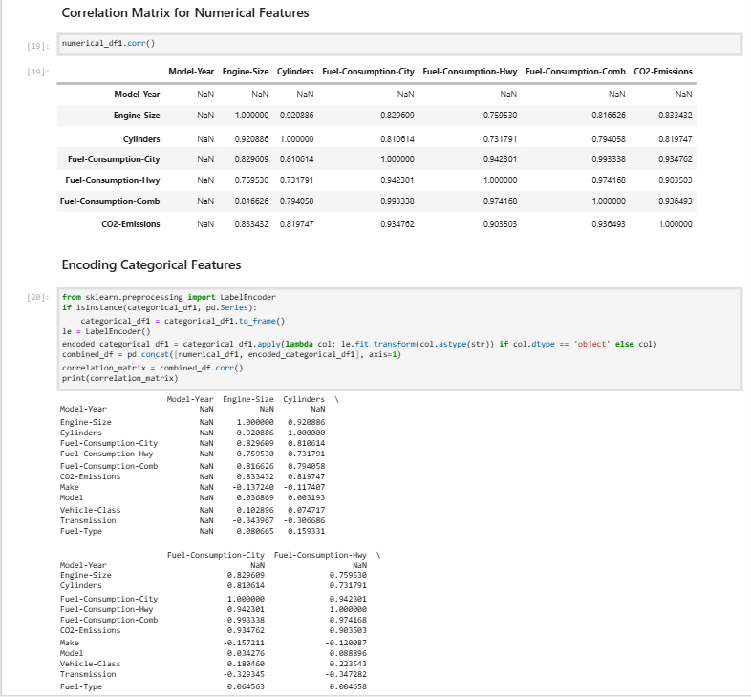

Slide 16
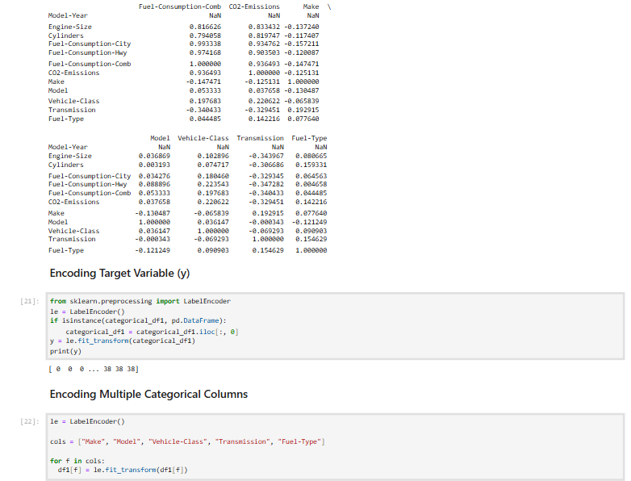

Slide 17
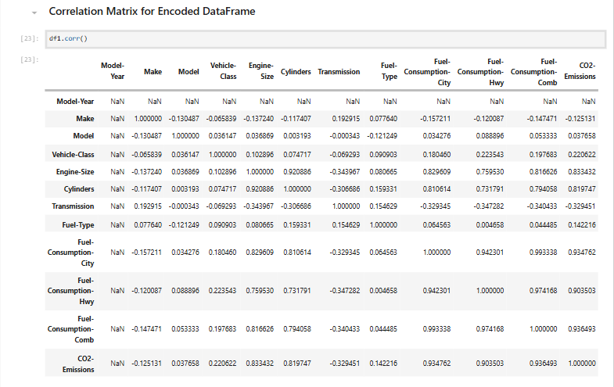

Slide 18
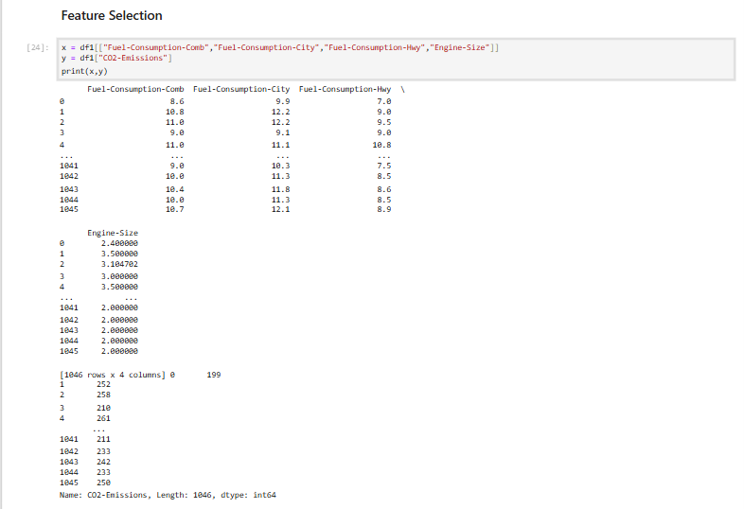

Slide 19
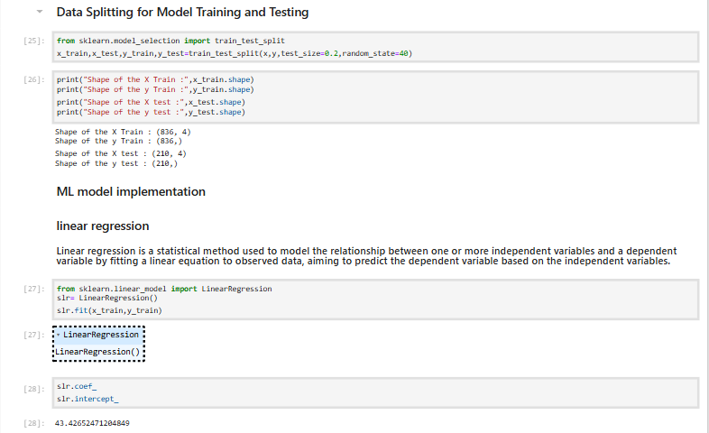

Slide 20
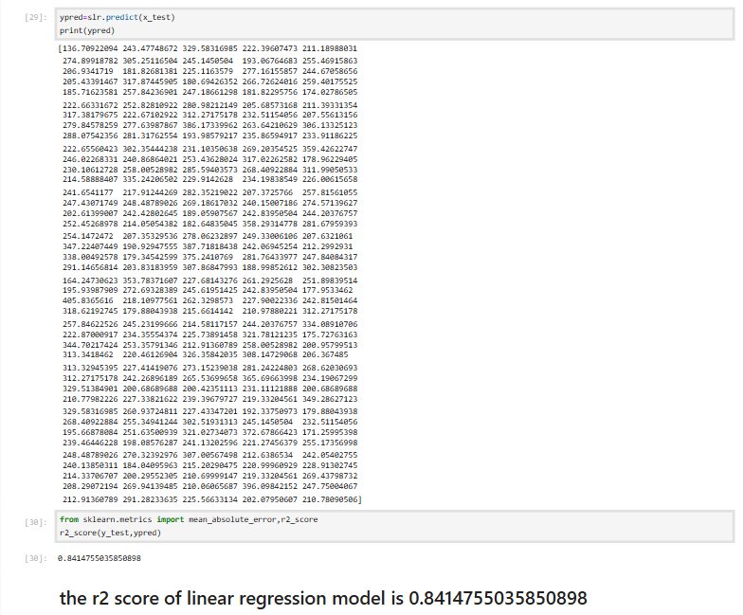

Slide 21
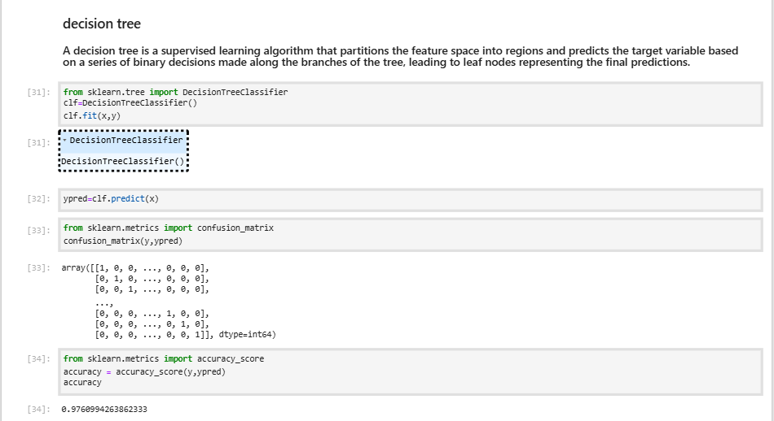

Slide 22
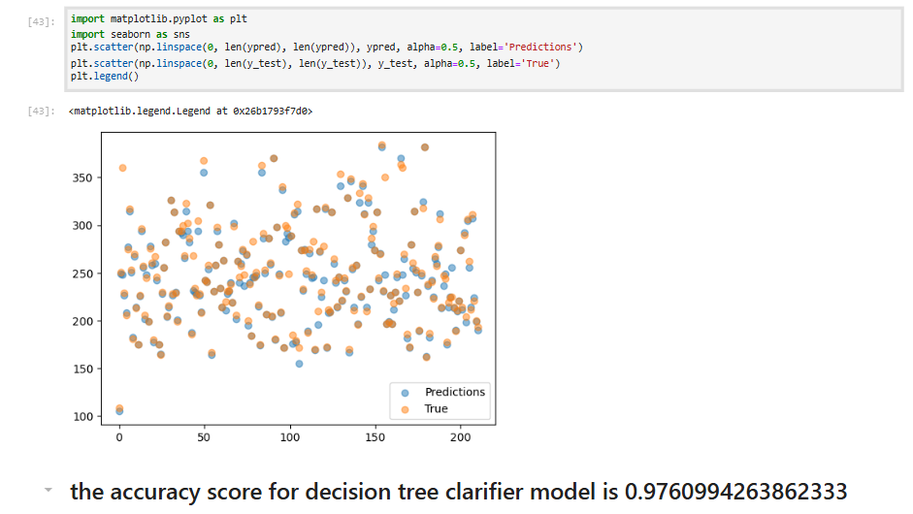

Slide 23
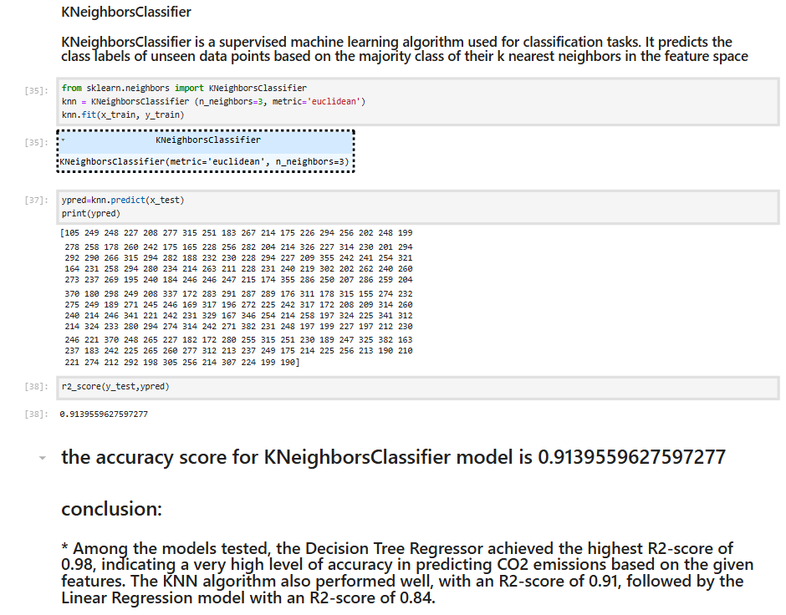

Slide 24
Conclusion
The study emphasizes the importance of machine learning in addressing environmental challenges in the automotive industry. The Decision Tree model, in particular, showed high potential for practical applications in emission predictions. Future work could explore advanced algorithms, additional features, and the impact of hybrid or electric vehicles on CO2 emissions. This project highlights the potential of machine learning to drive advancements in eco-friendly vehicle design and regulatory compliance.

Slide 25
THANK YOU

